Slide 1


Helping Nurses Thrive
Ahnyel Burkes, RN
Anil Punjabi
Charlene Platon, FNP
Chris Caulfield, FNP
Jillian Littlefield, RN
Kathy Shaffer, RN
Kristy Peterson, RN
Laura Deschere
Natale Burton, FNP
Xiaoyun Cong, RN
Notes:
Nurses experience a variety of work-related stressors that can result in compassion fatigue, Anxiety, PTSD, Burn out, and Moral Distress.
Its vital to support strategies to build resilience in order to prevent these issues from occurring.

Slide 2
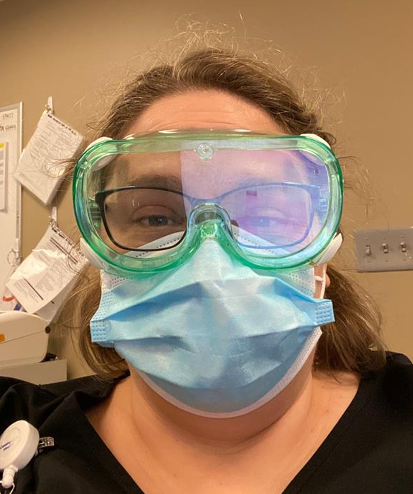
Kristy Peterson, RN – Team #5 Member
“As a nurse on the front lines of COVID-19, I really would have appreciated a resource to help me with coping and the stress I’ve been facing. One of my good colleagues passed away recently and it’s been a lot.”
- Kristy

Slide 3
THE PROBLEM
Limited NURSE-specific COPING tools addressing professional related
STRESS & ANXIETY
Notes:
The Problem:
Today there are Limited, Nurse- Specific, coping tools which address Professional Related Stress & Anxiety, while these conditions have been increasingly exacerbated due to the COVID-19 pandemic.

Slide 4


THE PROBLEM
Traditional Interventions = Limited REACH
TECH Solutions NOT designed for End User
Expected Adoption Rate = NOT to its Potential
Notes:
We’ve heard first hand accounts of barriers with traditional therapy due to:
concerns over mistrust or sharing of information with employers,
speaking to someone who DOES NOT ‘truly’ understand what it's like on the Front Line,
AND the Lack available resources.
When taking a Look at the Existing Tech solutions to deal with these Issues, They are Unfortunately Not Design for our END USER, the Nurse.
Due to these issues, Adoption Rates of these ‘tech solutions’ will NOT be at its potential Impact Level…
Until Now…...

Slide 5
THE SOLUTION
A “NURSE first” mobile app providing COPING INTERVENTIONS designed
by NURSES for NURSES
Notes:
Introducing, THe WELL NURSE Solution:
A truly NURSE FIRST solution accessible via a Mobile App to Provide Coping Interventions Designed by Nurses FOR Nurses.

Slide 6
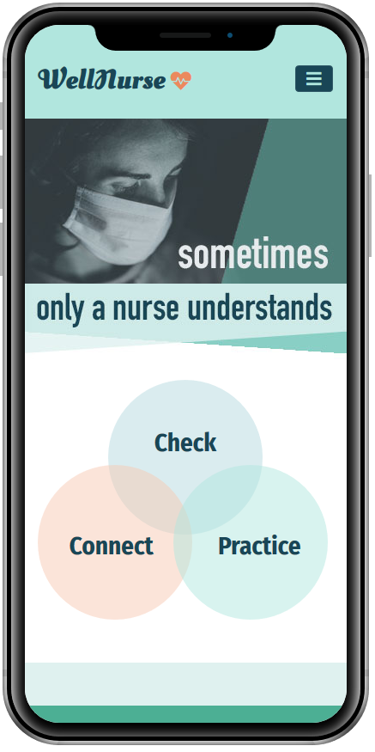
THE SOLUTION
Notes:
Our Mobile solution meets nurses where they, in between their busy and unpredictable Lives.
Our interventions are designed and tailored around the unique culture of nursing using evidence based interventions proven to be effective from a both a Mobile perspective ,as well as ‘Nurse first’ perspective.
In addition to the Robust and strategically designed ‘wellness tools’ AND stress level ‘Assessment’ Checker,
We’ve added a ‘Community Space”, called ‘Connect’ that allows Nurses to now have their Resources, Tools, and Social Protection, All in one ”Holistic” App.

Slide 7
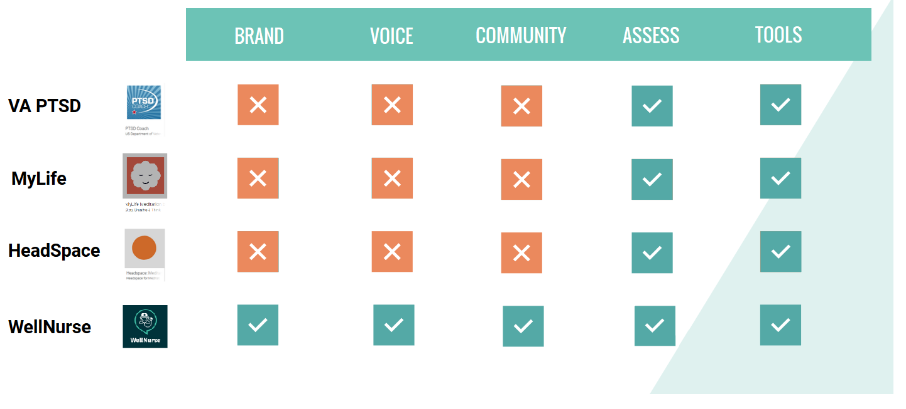
What Makes Unique?
Nurse
Nurse
Nurse
Notes:
So What really makes WELL NURSE Unique?
Our ‘by Nurses FOR Nurses’ design process is the Answer.
We ensure the Voice of the Nurse is presented, and the ‘In context’ learning is relevant to their work-life situations.
Other wellness apps have had great ‘traction’ in downloads and engagement,
but don’t have our Unique ‘user’ group which allows WELL NURSE to build a Community of support for Nurses, while the competitors won’t be able to offer this strategic advantage.

Slide 8
01
02
03
CAPITAL: COVID-19 GRANT
Public & Private Awards are Available.
BUSINESS MODEL
Partnership Model
White labeling opportunity [Nursing Organizations]
Social Marketing
Encourage & Empower nurses to share for a ‘CAUSE’.
04
Long Term Sustainability [Post COVID]
Tiered ‘subscriptions’, Ads, B2B wellness metrics for organizations
Notes:
OUR Business Model.
First, Our we have the Initial goal of delivering Holistic Tool to as many Nurses as Possible.
So we’ve identified several Grants supporting technology development related to COVID-19 response efforts.
Next, We’ll partner with National, and International Nursing Organizations to provide them the opportunity to ‘white label’ our product to benefit their organizations..
We’ll stimulate ‘social shares’ by Encouraging & Empowering Nurses to share for a ‘CAUSE’.
And Finally,long term term sustainability can be obtained through various strategies such as:
-Tiered Subscriptions
-Ads
-and a B2b Wellness Metrics and Insights for Healthcare Organizations

Slide 9
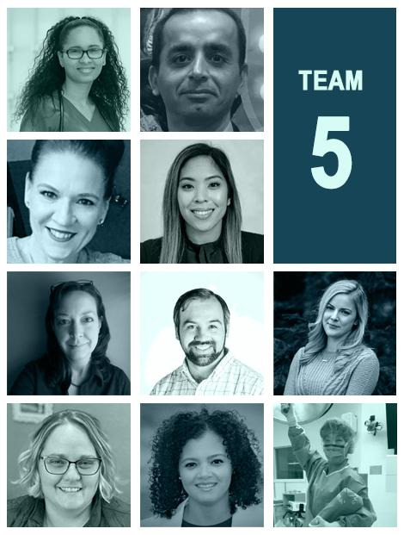
Meet Team
Nurses and Technical experts dedicated to helping nurses thrive
Ahnyel Burkes, RN
Anil Punjabi
Charlene Platon, FNP
Chris Caulfield, FNP
Jillian Littlefield, RN
Kathy Shaffer, RN
Kristy Peterson, RN
Laura Deschere
Natale Burton, FNP
Xiaoyun Cong, RN
Notes:
Why Have Confidence in Well Nurse?
Our team is a well diverse, multi-disciplinary mission driven organization that Feel Strong about the Nurses well being.
We understand the micro and macro consequences of NOT solving these big issues and the right team to implement a ‘roll out’ strategy that can be delivered at a pace that will actually have an IMPACT in the future of Nursing.

Slide 10
THANK YOU
Do you have any questions?
Future Domain:
http://WellNurse.com
Please keep this slide for attribution.

